Slide 1

Research and Development Python Multithreading -
Data Encryption Standard Algorithm
Presented by students:
Viatcheslav Kagan
Liad Khamdadash
March - June 2020
10356 Programming languages Seminar, Afeka, Spring Semester, Dr. Aviv Itzhak

Slide 2


Seminar Technologies:
Python language
Multithreading programming
Our goal:
Implementation of Data Encryption
Standard algorithm while using
python multithreading technique

Slide 3
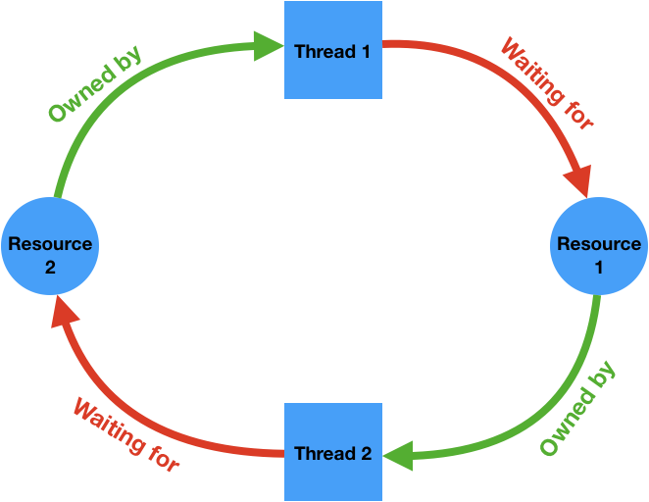
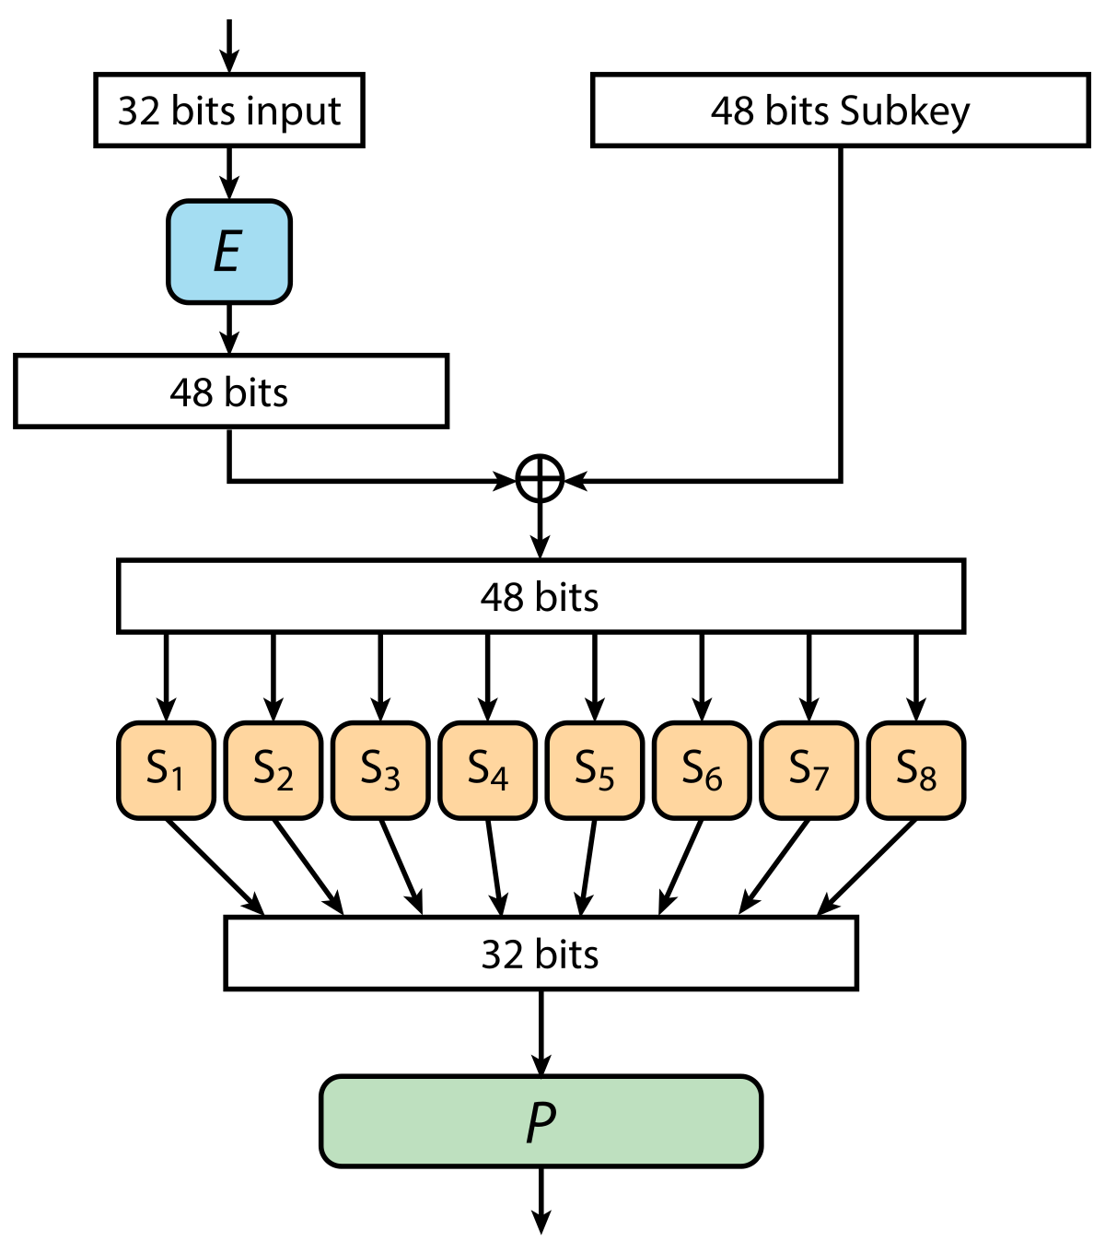
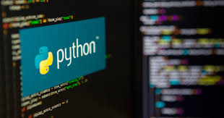

Slide 4


Slide 5
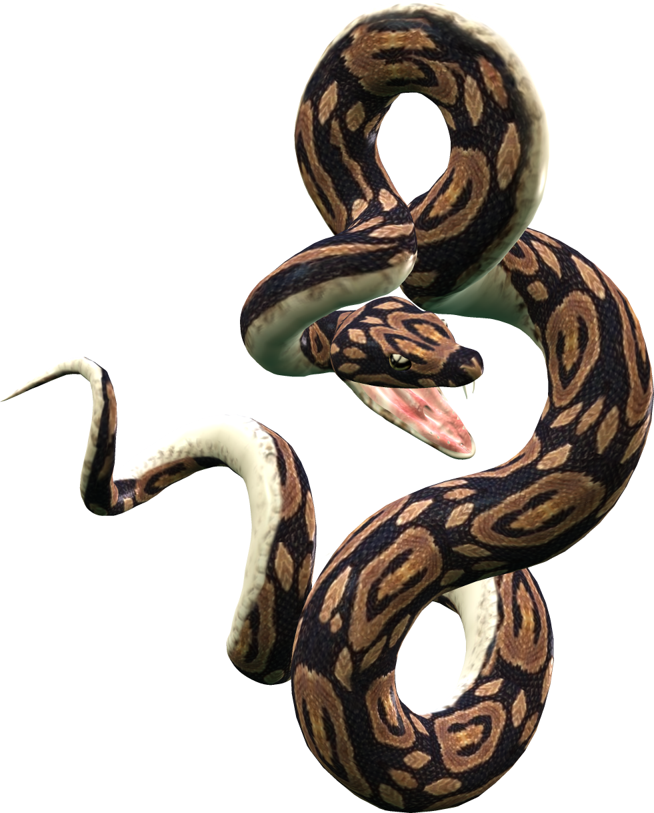
Python is an interpreted language (execute instructions directly without compiling a program into machine-language instructions) high-level, general-purpose programming language. first released in 1991, Python's design philosophy emphasizes code readability with its notable use of significant whitespace. Its language constructs, and object-oriented approach, aim to help programmers write clear, logical code for small and large-scale projects.
Python is dynamically typed and garbage collected.

Slide 6
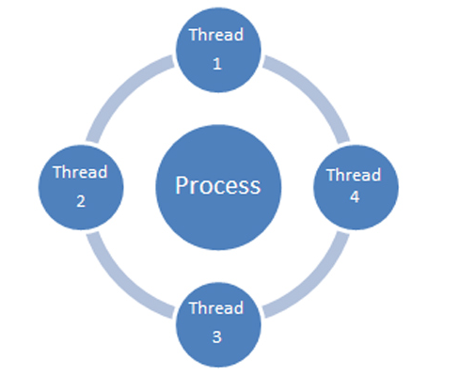
Multithreading

Slide 7

What is thread?
A thread is a path which is followed during a program’s execution. Majority of programs run as a single thread. For example, a program is not capable of reading keystrokes while making drawings. These tasks cannot be executed by the program at the same time. This problem can be solved through multitasking so that two or more tasks can be executed simultaneously.

Slide 8
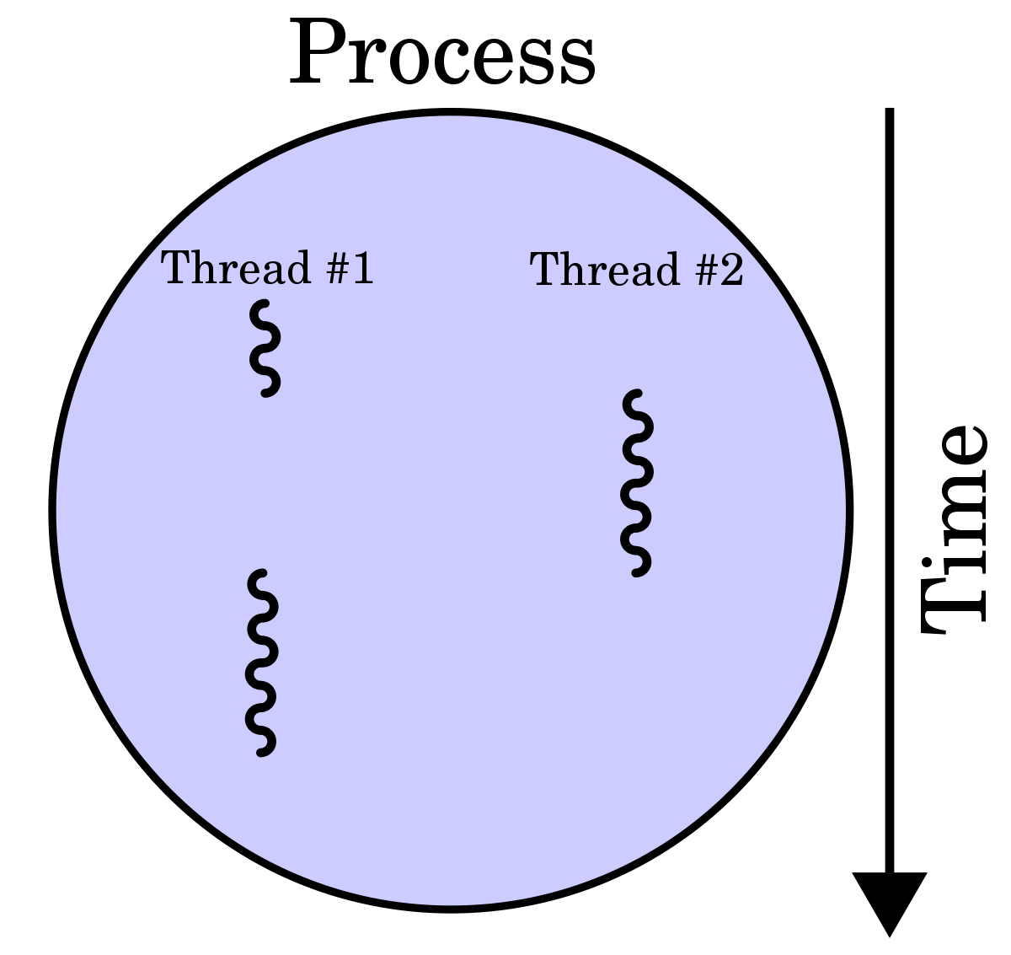
So, What is Multithreading?
Multithreading is the ability of a central processing unit (CPU) (or a single core in a multi-core processor) to provide multiple threads of execution concurrently, supported by the operating system. This approach differs from multiprocessing. In a multithreaded application, the threads share the resources of a single or multiple cores, which include the computing units, the CPU caches, and the translation lookaside buffer (TLB).

Slide 9
Fork

Slide 10

Fork?!
The system function call fork() creates a copy of the process, which has called it. This copy runs as a child process of the calling process. The child process gets the data and the code of the parent process. The child process receives a process number (PID, Process IDentifier) of its own from the operating system. The child process runs as an independent instance, this means independent of a parent process.

Slide 11
Thread Pool

Slide 12
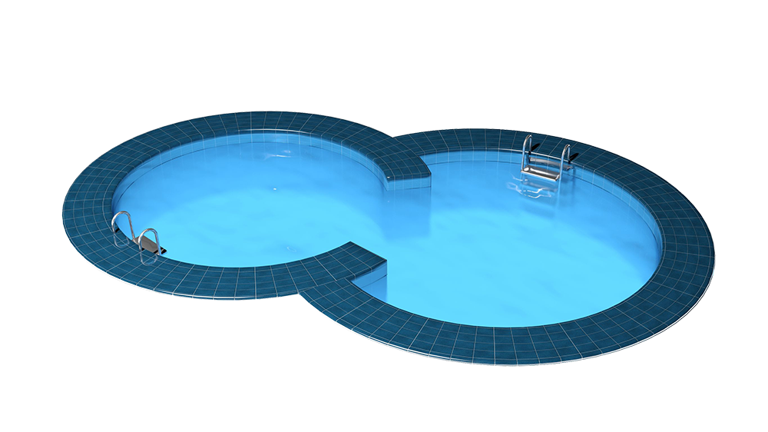
Pool?!
A process pool object which controls a pool of worker processes to which jobs can be submitted. It supports asynchronous results with timeouts and callbacks and has a parallel map implementation. processes are the number of worker processes to use. The threads are the number of threads that you want and tasks are a list of tasks that most map to the service.

Slide 13

Cryptography

Slide 14

Cryptography is a method of protecting information and communications through the use of codes so that only those for whom the information is intended can read and process it. The pre-fix "crypt" means "hidden" or "vault" and the suffix "graphy" stands for "writing."
Cryptography involves creating written or generated codes that allow information to be kept secret.
The information cannot be read without a key to decrypt it. It maintains its integrity during transit and while being stored.

Slide 15


Slide 16
DES is a block cipher algorithm that takes plain text in blocks of 64 bits and converts them to ciphertext using keys of 48 bits. It is a symmetric key algorithm, which means that the same key is used for encrypting and decrypting ​data. Both the sender and the receiver must know and use the same private key.
It is the most popular security algorithm and has been found vulnerable against very powerful attacks and therefore, the popularity has been found slightly on decline.

Slide 17
For example, if we take the plaintext message "8787878787878787",
and encrypt it with the DES key: "0E329232EA6D0D73", we end up with the ciphertext "0000000000000000".
If the ciphertext is decrypted with the same secret DES key "0E329232EA6D0D73",
the result is the original plaintext "8787878787878787".

Slide 18
DES is based on the two fundamental attributes of cryptography: substitution (also called as confusion) and transposition (also called as diffusion). DES consists of 16 steps, each of which is called as a round. Each round performs the steps of substitution and transposition.

Slide 19
In the first step, the 64 bit plain text block is handed over to an initial Permutation (IP) function.
The initial permutation performed on plain text.
Next the initial permutation (IP) produces two halves of the permuted block; says Left Plain Text (LPT) and Right Plain Text (RPT).
Now each LPT and RPT to go through 16 rounds of encryption process.
In the end, LPT and RPT are rejoined and a Final Permutation (FP) is performed on the combined block
The result of this process produces 64 bit cipher text.

Slide 20
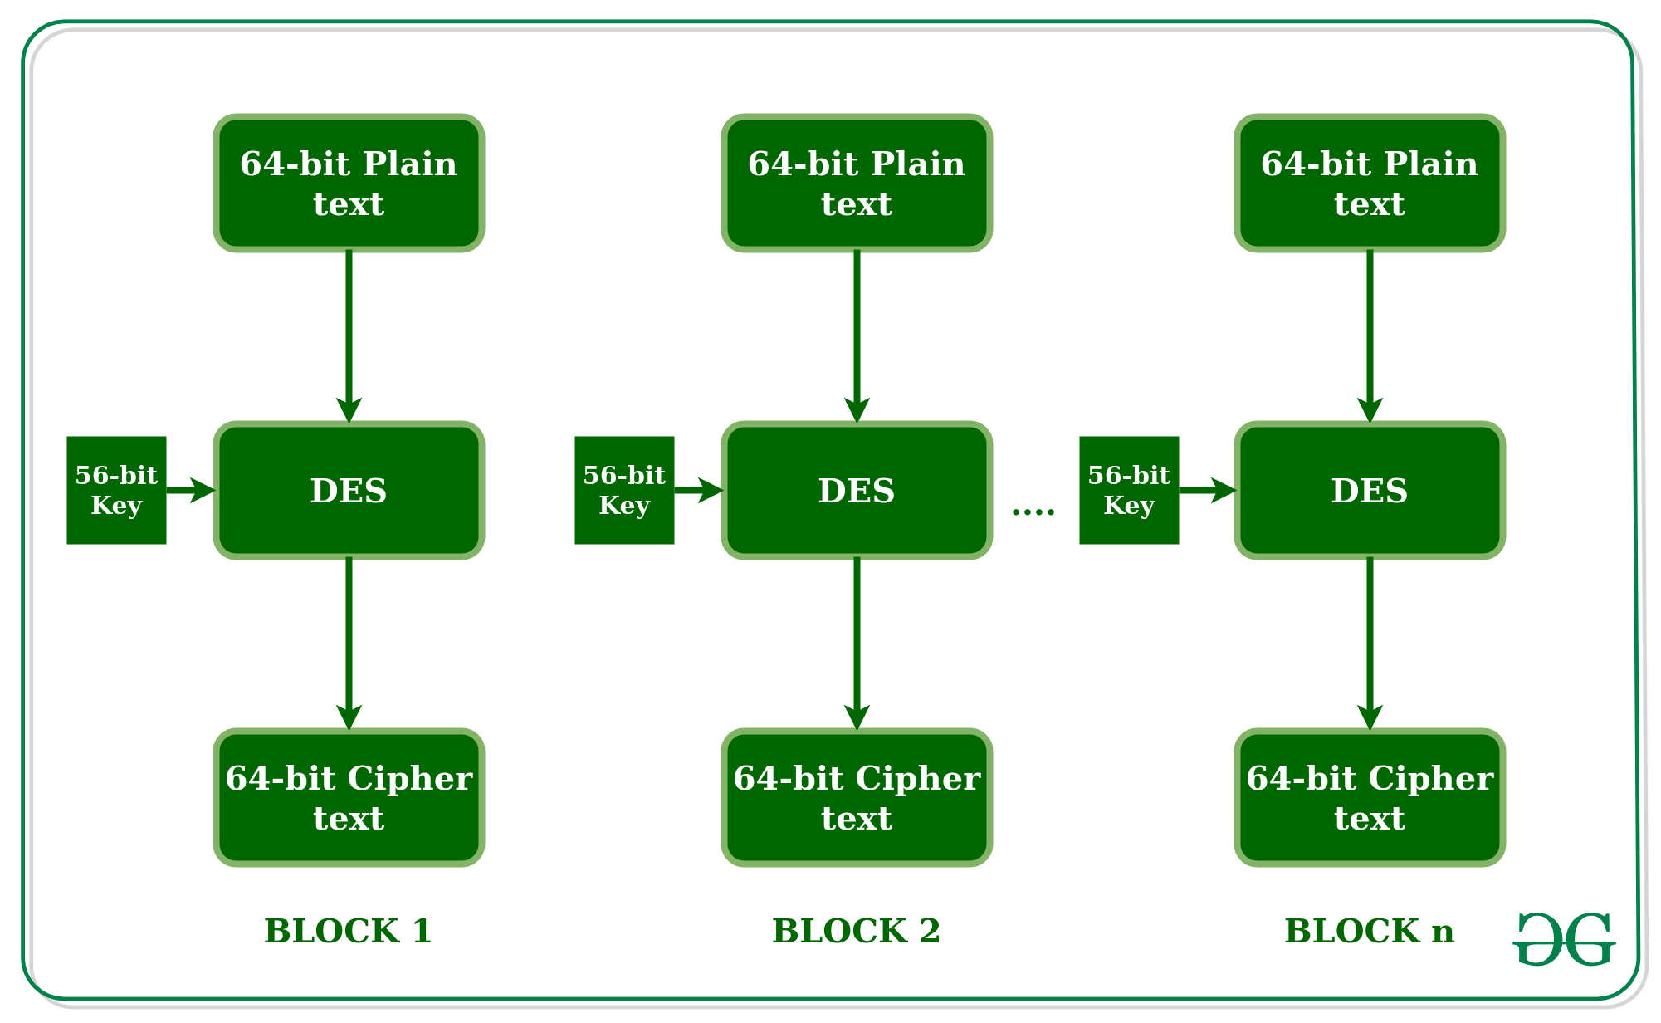

Slide 21
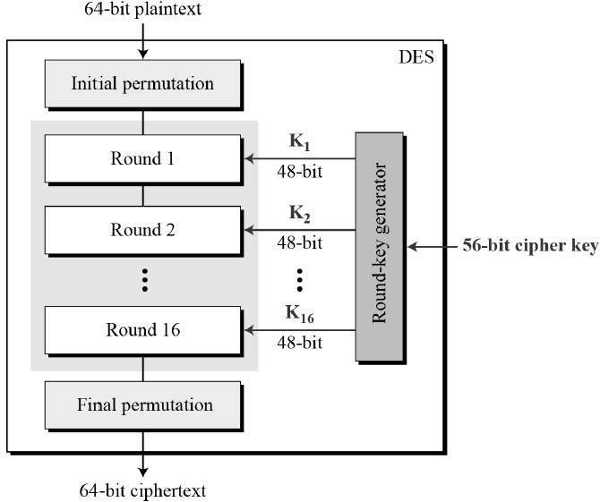

Slide 22
Sequential
Code

Slide 23
Code and explanations:
Sequential programming is when the algorithm to be solved consists of operations one after the other and you do not have to do alternative operations.
In our code we just implement the whole algorhitm we explained before using all the blocks and tables for that.

Slide 24
Parallel Code
Threads

Slide 25
Code and explanations:
We implement Pool Thread Way and Fork Thread Way. Got time running results that are worse than in sequential code. In both ways we used threads from libraries that imported it.

Slide 26
Why parallel
solution better
than Sequential In General?

Slide 27
Multithreading solution is:
Reduces the time consumption/ response time
Improving performance and faster access
Simplifies the code
Better utilization of resources
Allows concurrent and parallel occurrence of various tasks

Slide 28
So, In Python is also good way??
NO!
The default implementation of Python ‘CPython’ uses GIL (Global Interpreter Lock) to execute exactly one thread at the same time, even if run on a multi-core processor as GIL works only on one core regardless of the number of cores present in the machine.
Multithreading does not make much of a difference in execution time as it uses the same memory space and a single GIL, so any CPU-bound tasks do not have an impact on the performance of the multi-threaded programs

Slide 29
Time Results

Slide 30
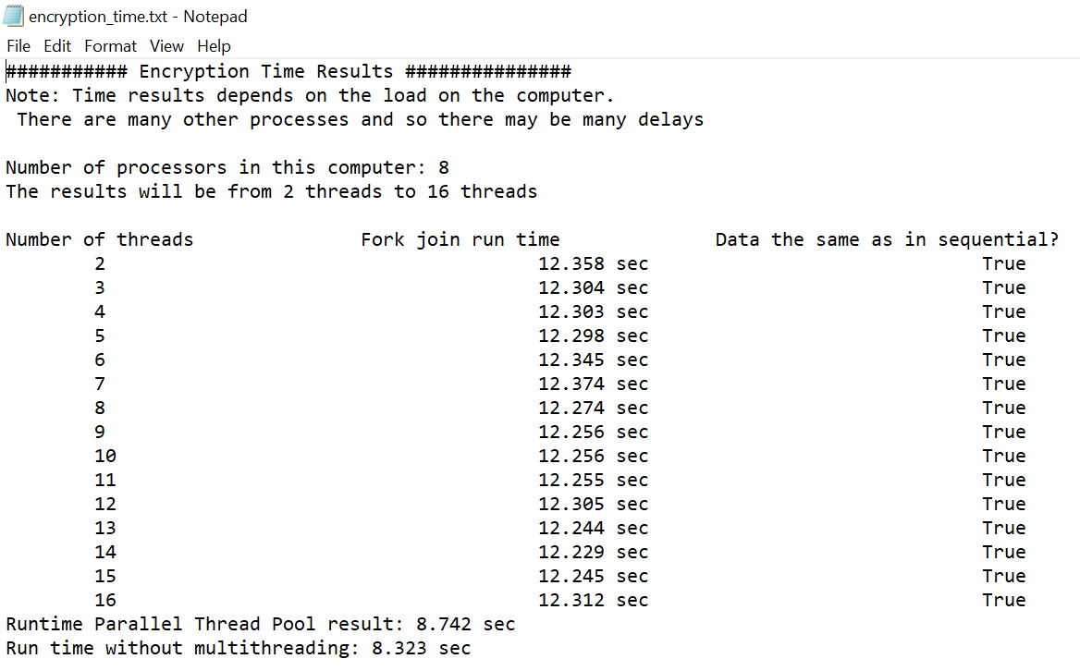
Time results Encryption:

Slide 31
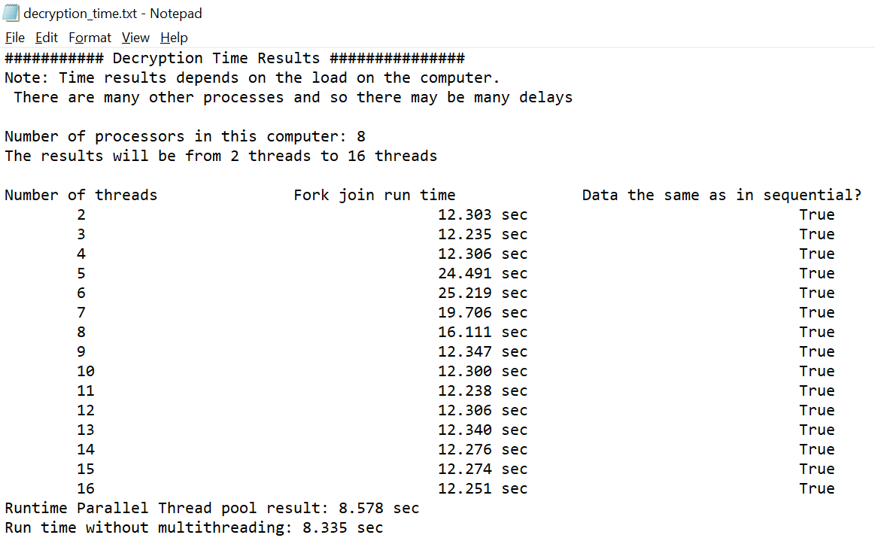
Time results Decryption:

Slide 32

THANKS!
Enjoy our
work!
Any questions?
You can find us at
slava15.92@gmail.com
liadkh95@gmail.com

